Slide 1
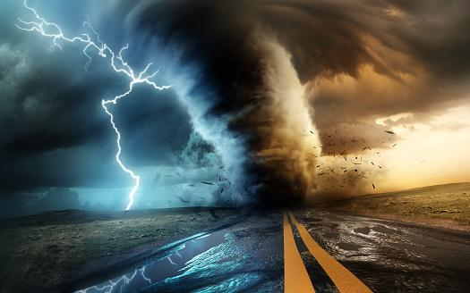

AI-2 PROJECT
Classifying Buildings Post-Hurricane
TEAM ACES
▶ ANJANA K MENON
▶ KUNAL JAIN
▶ JOYSON CHACKO GEORGE
▶ ARJUN BENOY

Slide 2
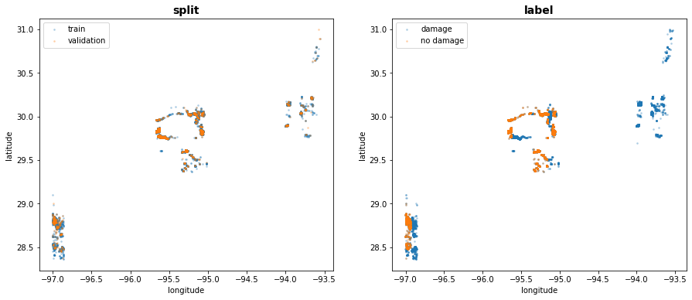

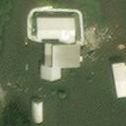
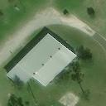
The DATA…..
Dataset length:
Spatial Distribution of the Disaster
 | Damage | No Damage
Train | 5000 | 5000
Validation | 1000 | 1000
Test -1 | 1000 | 1000
Test -2 | 8000 | 1000
Sample Image :
Damage❌
No Damage✅

Slide 3

The Methodology
Data Pre-Processing
Importing
Visualizing
Augmenting
Comparing Models performance of
1. Grayscale and RGB
images
2. Sharpened and
non-Sharpened
images
CNN Model
With RGB image
With Grayscale image
Saliency Mapping
Saliency Map to visualize “what the Network is looking at” in each image for
classification.
Transfer Learning Model
With default image
With sharpened image
Saliency Mapping
Conclusion
Model Comparison
Project Outcome & Learning
Drawbacks & Improvisations

Slide 4
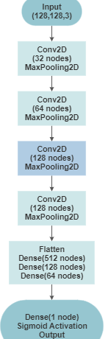
Model 1 : CNN Model
Model Architecture👉
Model with the shown architecture was trained on the data for both RGB colored images as well as Gray scale images.
The performance of both the Model has been tabulated in further slides.
Design Choices
Activation : “Relu”
Kernel size= (3,3)
Pool size= (2,2)
Optimizer : Adam(0.0001)

Slide 5
Comparing RGB and GrayScale Image Models
 | RGB | Grayscale
No. of Parameters | 45,09,633 | 45,09,057
Training Accuracy | 96.06% | 91.56%
Balanced test set accuracy | 97.37% | 89.68%
Unbalanced test set accuracy | 95.62% | 72.15%
Inferences:
The test accuracy for balanced test set was better than the unbalanced test set accuracy for both the models.
The RGB image model performed better than grayscale model - colour information in images helps the network to learn better features.

Slide 6
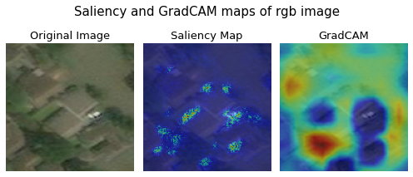
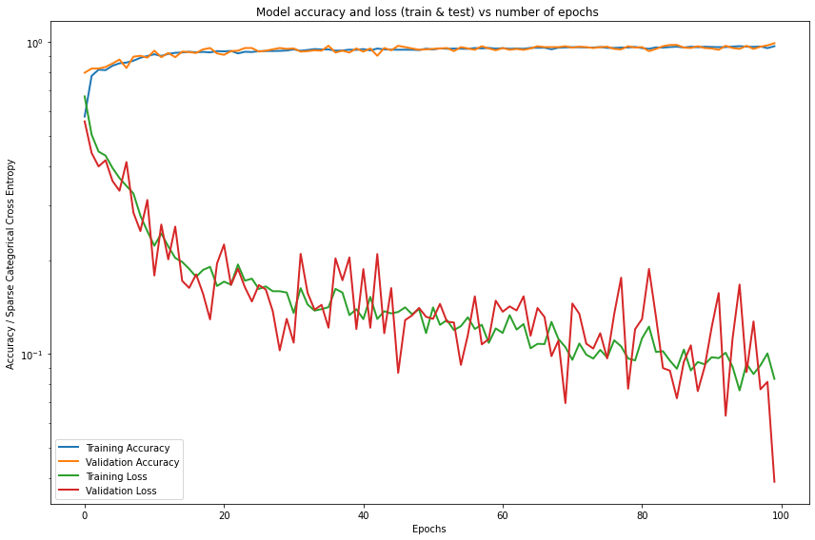
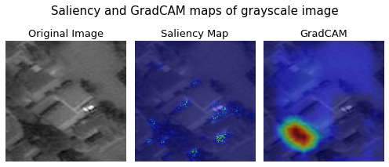
Model Analysis
Accuracy and Loss(graph)

Slide 7
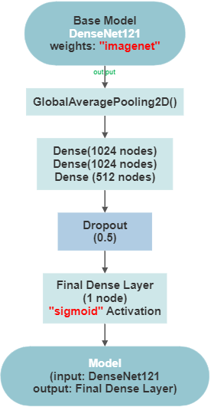
Model 2:
Transfer Learning Model
Model architecture👉
In this part, we have taken DenseNet121 as the base model with the “imagenet” weights and built the model using Transfer Learning techniques.
Here we have taken two types of images- Sharpened and Unsharpened images. Fitted the model with both the types and tabulated the results for comparison.
Design Choices:
Base Model : DenseNet121
Weights : Imagenet
Activation : Relu
Optimizer : Adam
Pooling : Average Pooling

Slide 8
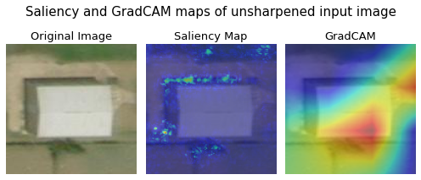
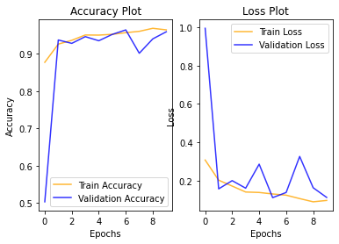
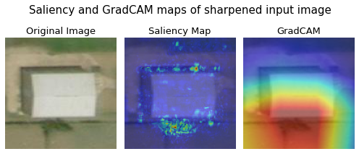
Model Analysis
Model Performance
Inference:
The features were concentrated on the outside of the building area for sharpened images whereas the model concentrated on the building for unsharpened images.

Slide 9
Model Comparisons
 | Unsharpened Image | Sharpened Image | CNN Model | Transfer Learning Model
No. of Parameters | 73,41,121 | 73,41,121 | 45,09,633 | 73,41,121
Training Accuracy | 95.93% | 93.93% | 96.06% | 95.93%
Balanced test set accuracy | 95.43% | 93.18% | 97.37% | 95.43%
Unbalanced test set accuracy | 92.31% | 97.25% | 95.62% | 92.31%
Key Findings:
The network did not perform well on the balanced test set of sharpened images.
But it performed very well on the unbalanced test dataset of sharpened images.
CNN model performed better for original RGB images in both balanced and unbalanced test set.

Slide 10
CONCLUSION
On the provided Hurricane Image Data, we built two models.
The 1st CNN Model tried to draw the difference in Model’s performance on Grey and RGB images.
The 2nd Transfer Learning Model worked with Sharpened and Unsharpened (RGB) images and tried to find out how the model results vary.
Finally we attempted to compare the CNN Model as well as the Transfer Learning Model and analysed the Saliency Maps to understand how the network classifies the data!

